Slide 1
Thus, some of the solid sugar will go into solution in the syrup. This will continue until the new equilibrium syrup concentration is established at the higher temperature.
In order to explain the phase diagram we will use a H2O system and including the effect of pressure and temperature as an example, which is shown Figure 19. Here it may be noted that regions for three different phases—solid, liquid, and vapour—are delineated on the plot. Each of the phases will exist under equilibrium conditions over the temperature–pressure ranges of its corresponding area. Furthermore, the three curves shown on the plot (labelled aO, bO, and cO) are phase boundaries; at any point on one of these curves, the two phases on either side of the curve are in equilibrium (or coexist) with one another.

Slide 2
That is, equilibrium between solid and vapour phases is along curve aO—likewise for the solid-liquid, curve bO, and the liquid vapour, curve cO. Also, upon crossing a boundary (as temperature and/or pressure is altered), one phase transforms to another. For example, at one atmosphere pressure, during heating the solid phase transforms to the liquid phase (i.e., melting occurs) at the point labelled 2 on Figure (i.e., the intersection of the dashed horizontal line with the solid-liquid phase boundary); this point corresponds to a temperature of 0o . Of course, the reverse transformation (liquid-to-solid, or solidification) takes place at the same point upon cooling. Similarly, at the intersection of the dashed line with the liquid-vapour phase boundary [point 3 (Figure), at 100oC] the liquid transforms to the vapour phase (or vaporizes) upon heating;

Slide 3
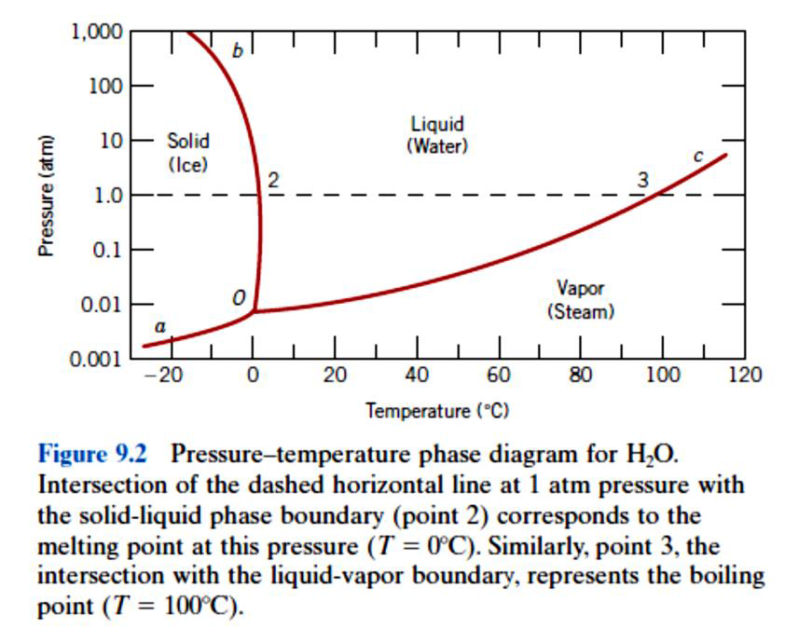
Figure 19 Pressure temperature phase diagram for H2O

Slide 4
5. Phase Diagrams (II)
A system is at equilibrium if at constant temperature, pressure and composition; the system is stable, not changing with time. Equilibrium is the state that is achieved given sufficient time. But the time to achieve equilibrium may be very long (the kinetics can be slow) that a state along the path to the equilibrium may appear to be stable. This is called a metastable state.
In thermodynamics the equilibrium is described as a state of a system that corresponds to the minimum of thermodynamic function called the free energy.
As we mention earlier, phase diagram is a graphical representation of all the equilibrium phases as a function of temperature, pressure, and composition.

Slide 5
5.1 Phase diagrams for binary systems
A phase diagrams show what phases exist at equilibrium and what phase transformations we can expect when we change one of the parameters of the system.
Real materials are almost always mixtures of different elements rather than pure substances: in addition to T and P, composition is also a variable.
We will limit our discussion of phase diagrams of multicomponent systems to binary alloys and will assume pressure to be constant at one atmosphere. Phase diagrams for materials with more than two components are complex and difficult to represent.
Isomorphous system - complete solid solubility of the two components (both in the liquid and solid phases) is shown in Figure 20.

Slide 6
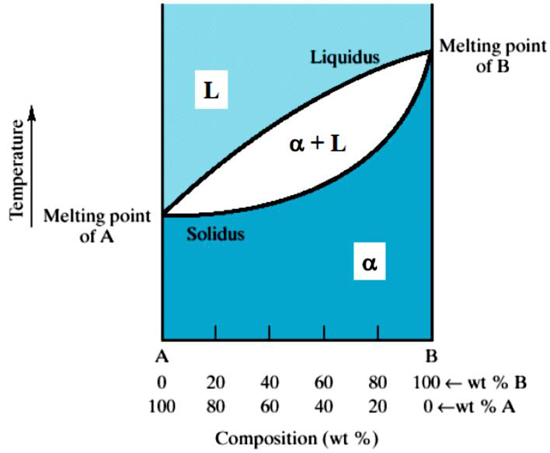
Figure 20 Isomorphous system - complete solid solubility of the two components

Slide 7
Three phase region can be identified on the phase diagram in Figure 20:
• Liquid (L) , solid + liquid (α +L), solid (α )
• Liquidus line separates liquid from liquid + solid
• Solidus line separates solid from liquid + solid
In one-component system melting occurs at a well-defined melting temperature. In multi-component systems melting occurs over the range of temperatures, between the solidus and liquidus lines. Solid and liquid phases are at equilibrium with each other in this temperature range.

Slide 8
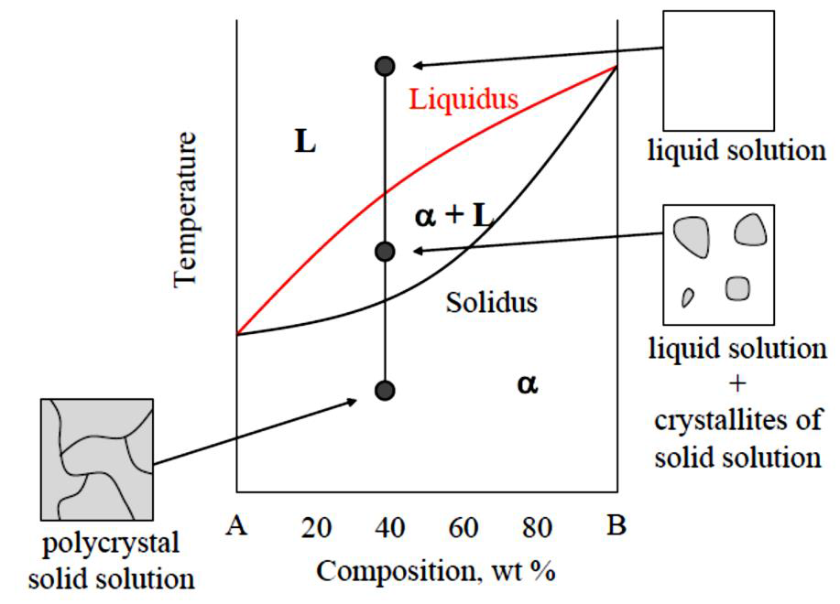
Figure 21 an example of the binary alloy system shoes liquids and solidus solid solution

